Slide 1
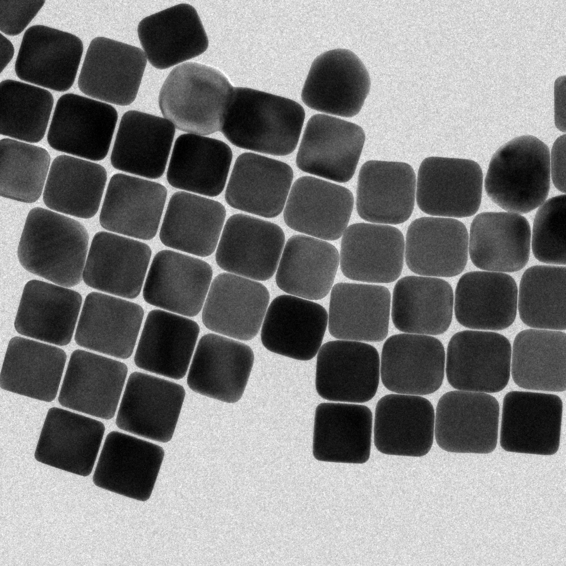
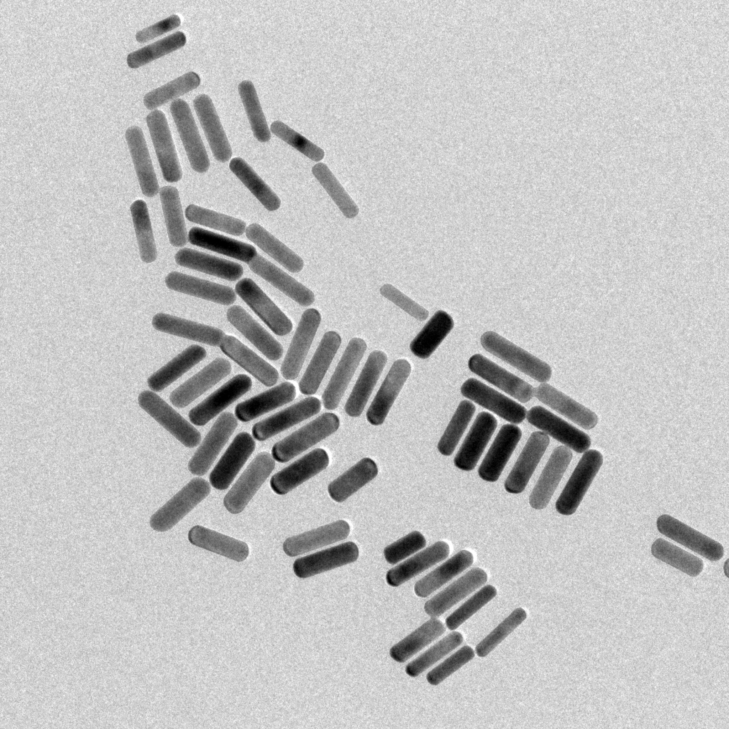
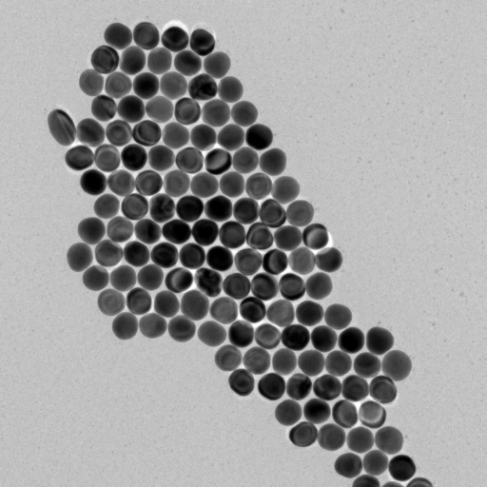
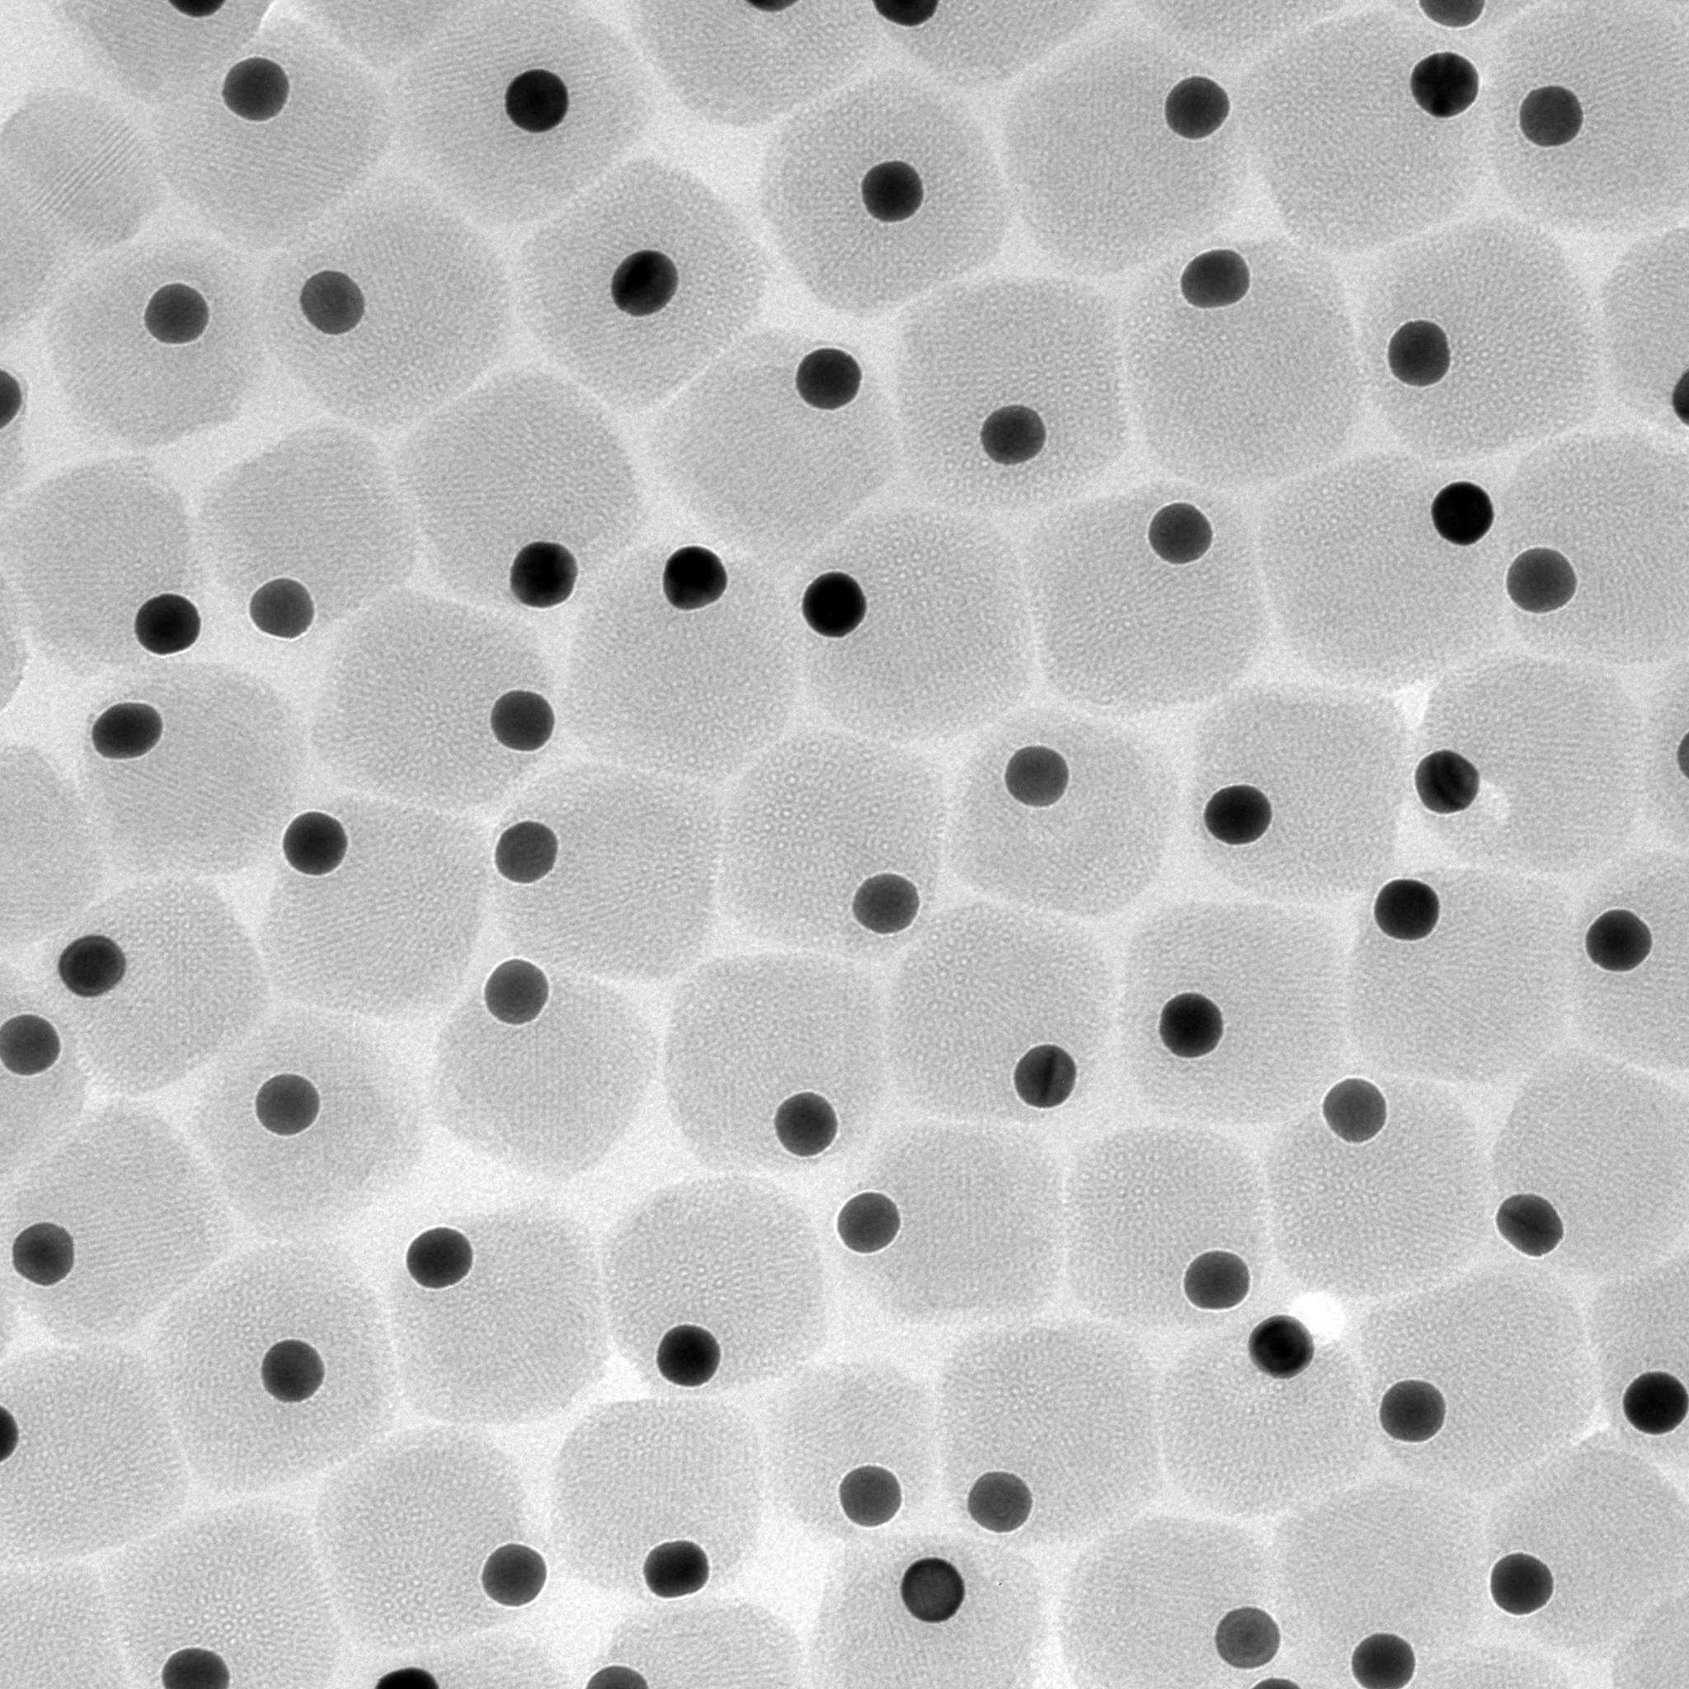
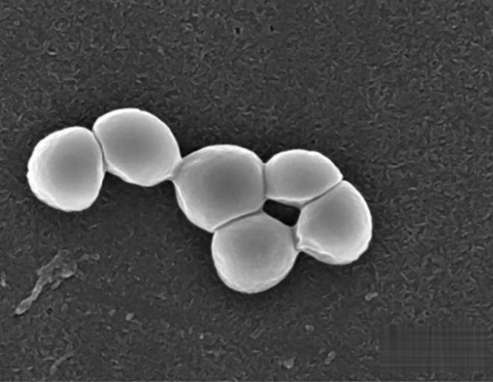
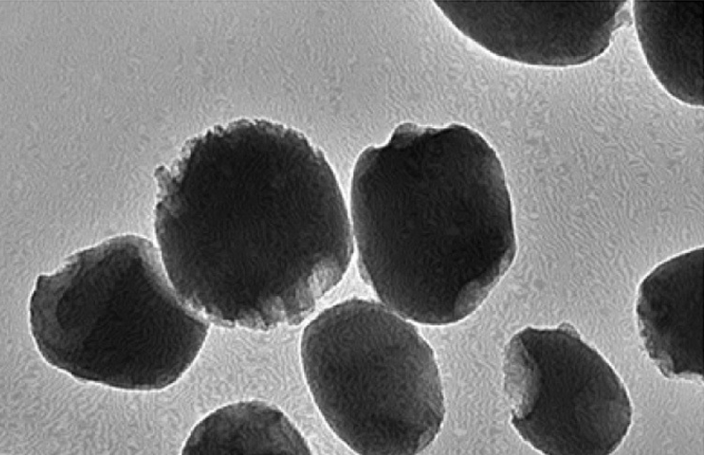
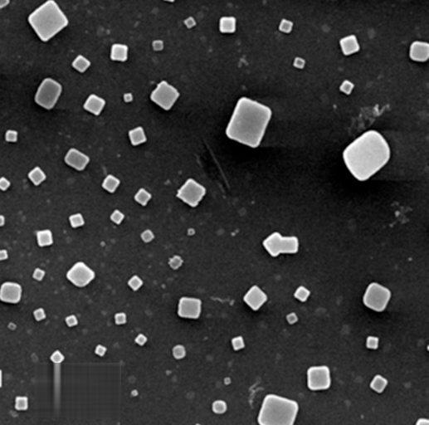
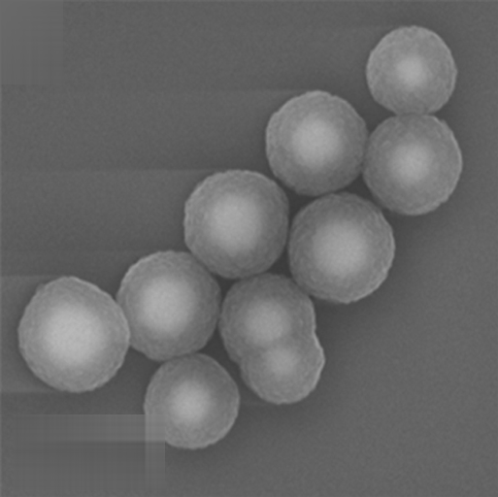
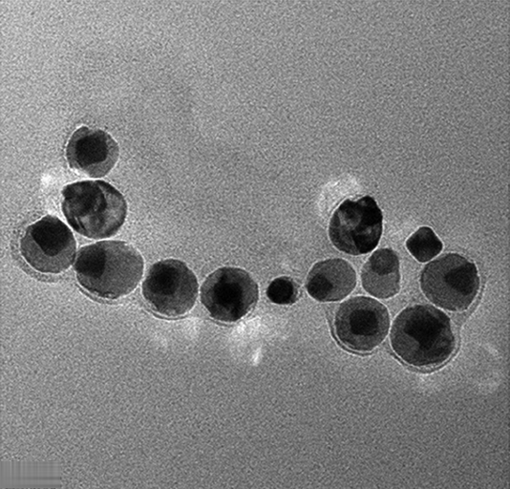
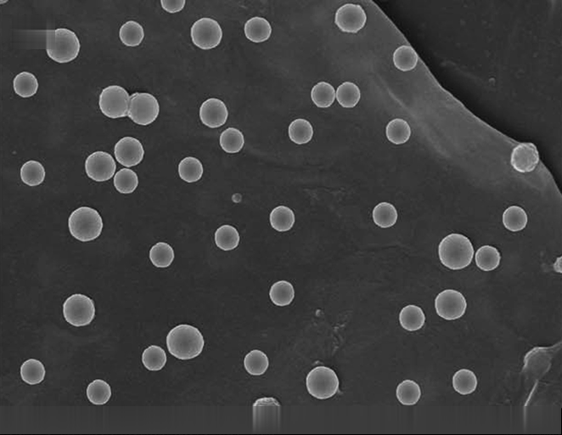
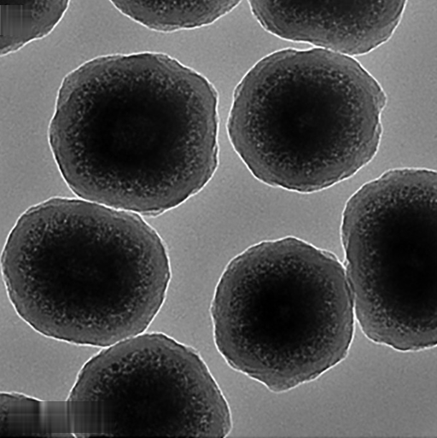
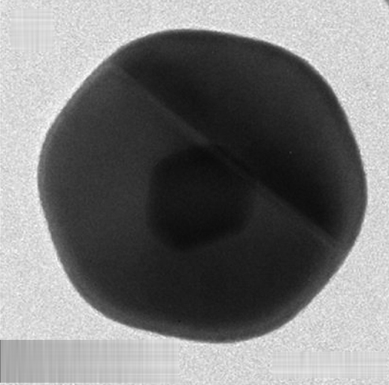
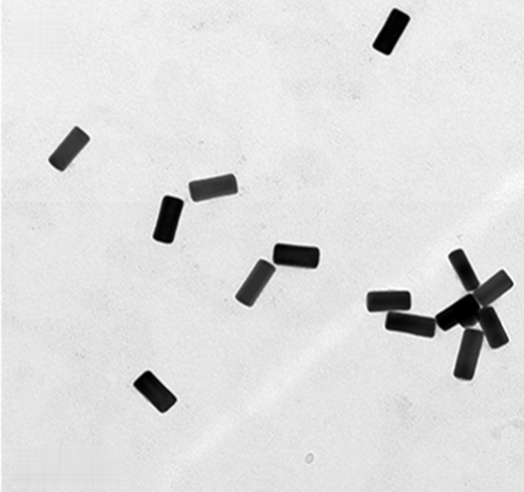
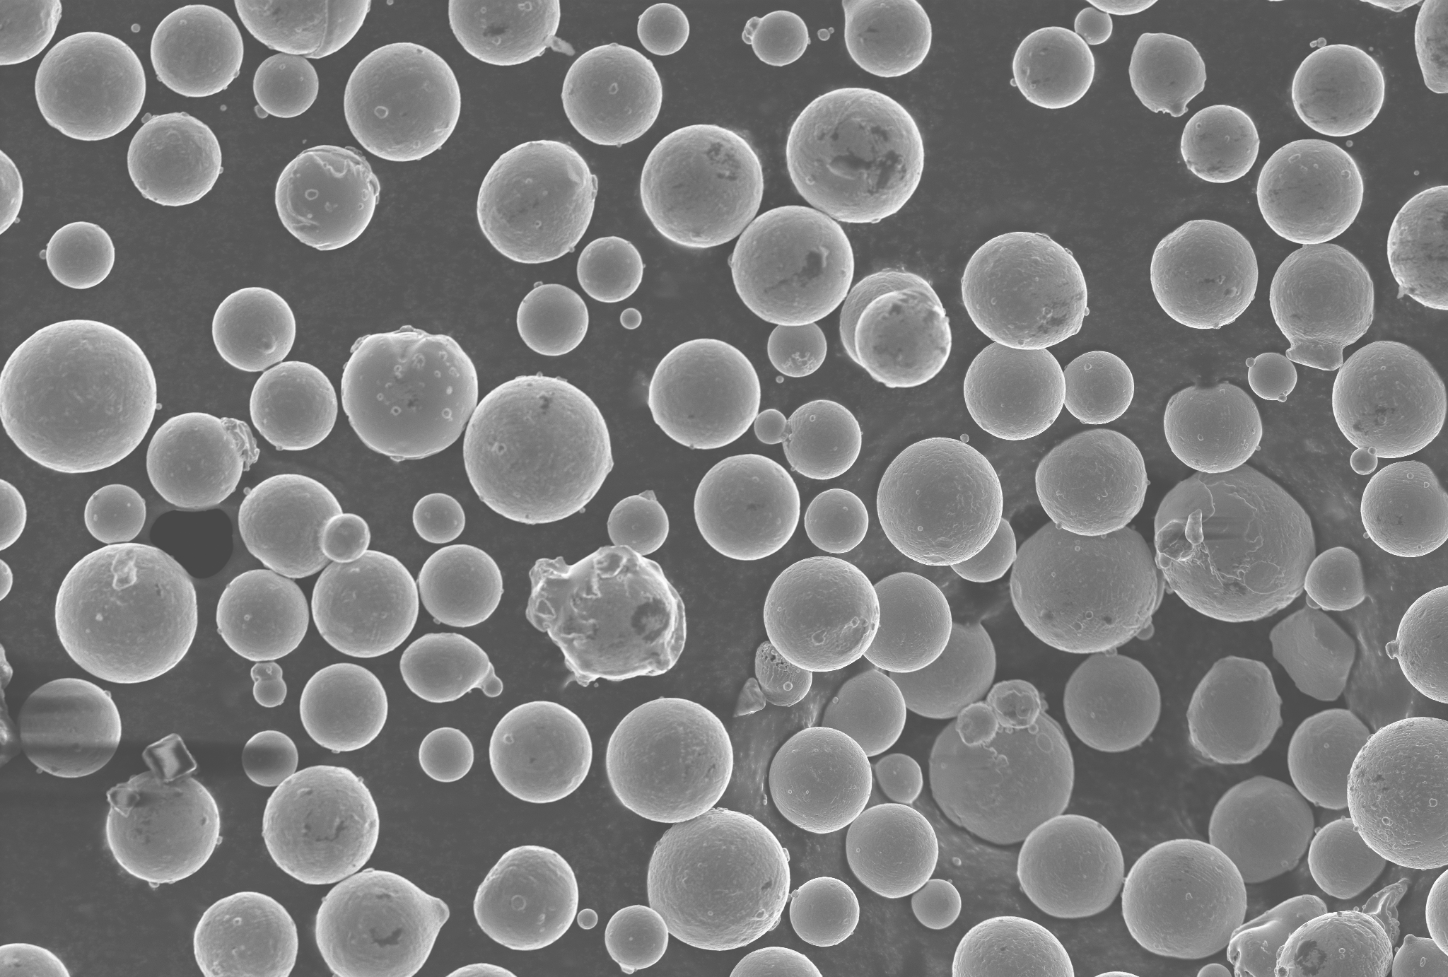
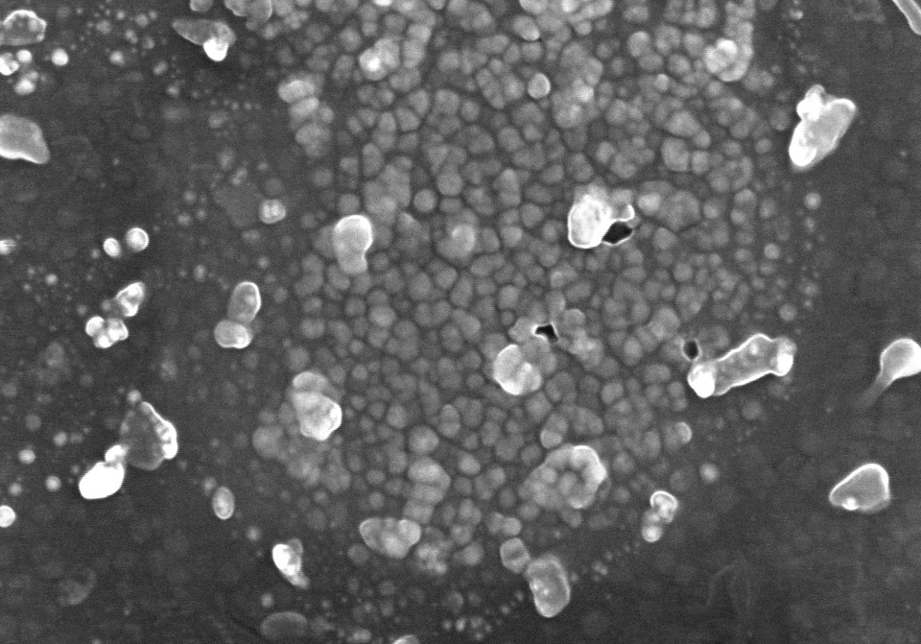
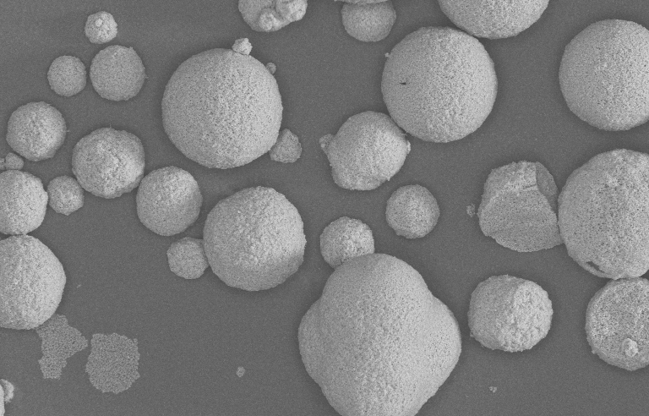
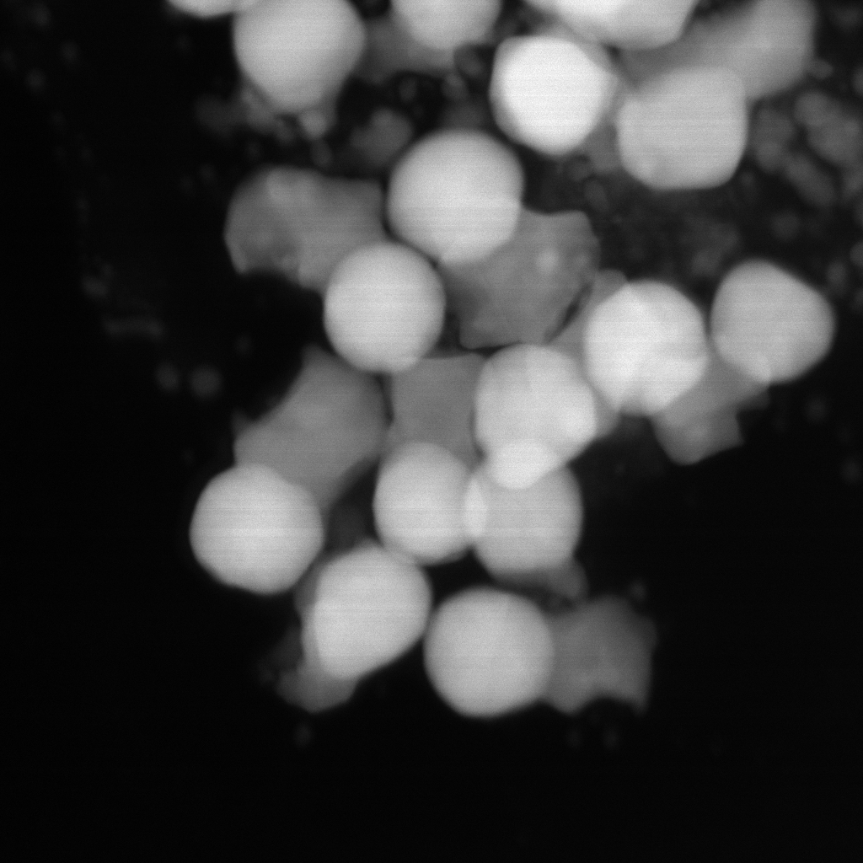
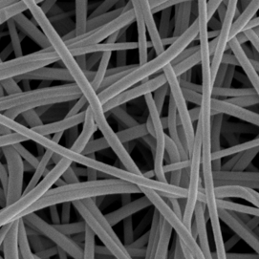
Nanocube
Nanorod
Nanosphere
Core-shell
Lyu’s
Kaggle
MCF
Figure 1. Representative images from the dataset, including nanocubes, nanorods, nanospheres, and core–shell structures obtained from Lyu’s dataset, Kaggle, and MCF.

Slide 2
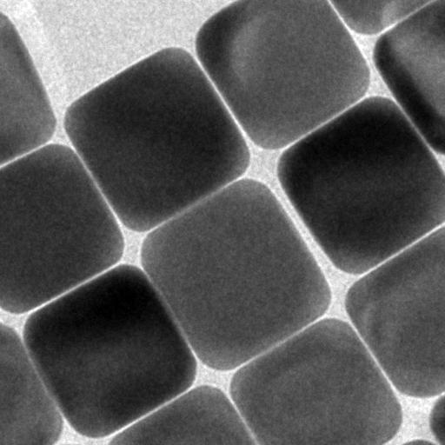
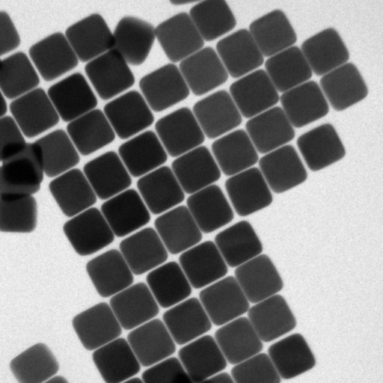
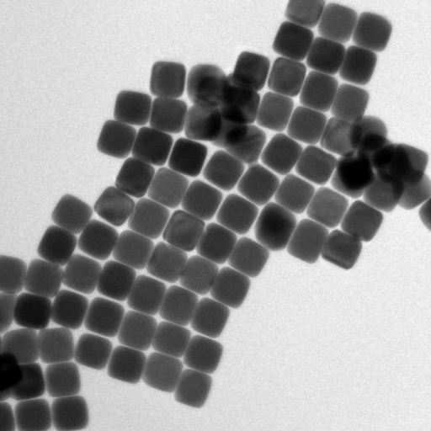
(a)
(b)
(c)
Figure 1.a. Well separated particles. b. one particle slightly overlap with neighbouring 3 particles. c. multiple nanoparticle overlapped together that human cannot recognize.

Slide 3
Cases
Strategies
Target result
Case 1: with background only
Preferred:
Smooth background: Telea, PDE, TV, or surface fitting
Texture background: Constrained PatchMatch or local patch synthesis
Advanced:
Smooth background: DCT-sparse or TEM-adapted inpainting
Texture background: TEM-adapted LaMa/partial convolution
Data cleaning
20 nm
Case 2: with particle only
Preferred:
Same-particle PatchMatch or directional interpolation
Advanced:
TEM-adapted inpainting
10 nm
Case 3: with background + particle
Preferred:
Manual shape completion plus separate filling
Advanced:
Morphology-assisted restoration
15 nm
Case 4: highly overlapped particles
Preferred:
Manual shape completion plus separate filling
Advanced:
Morphology-assisted restoration

Slide 4
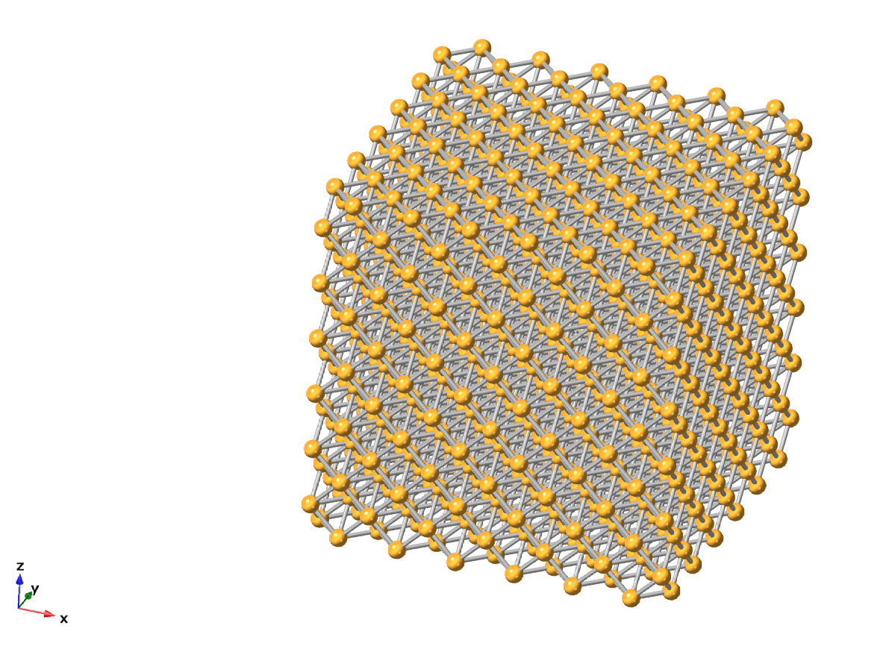
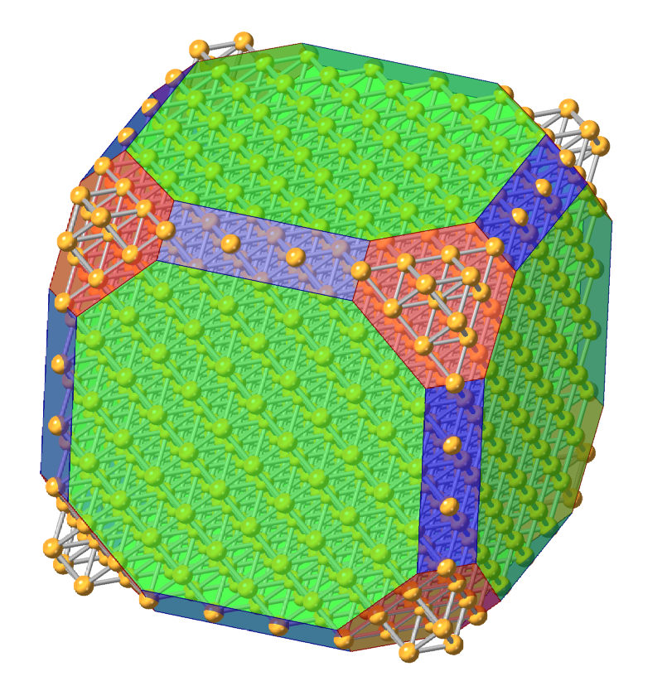
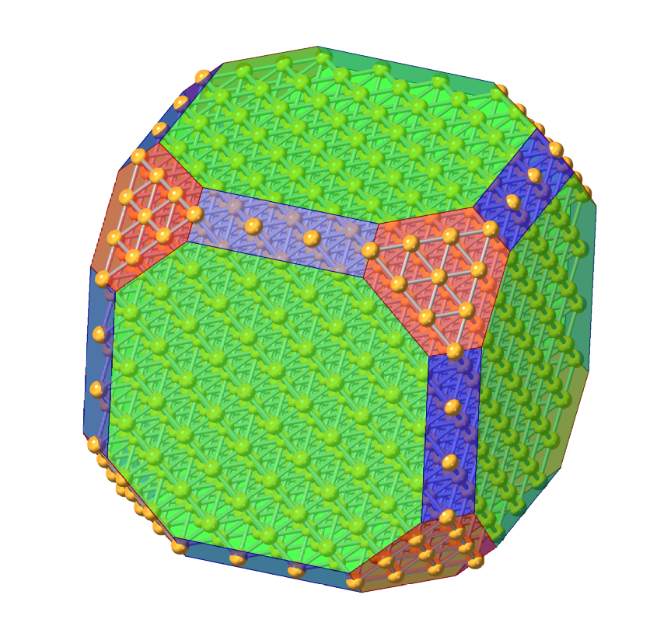
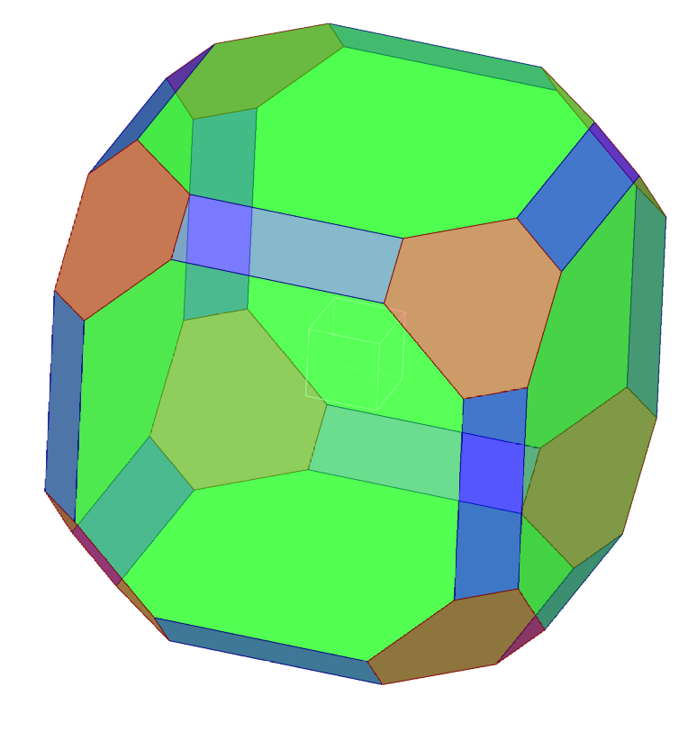
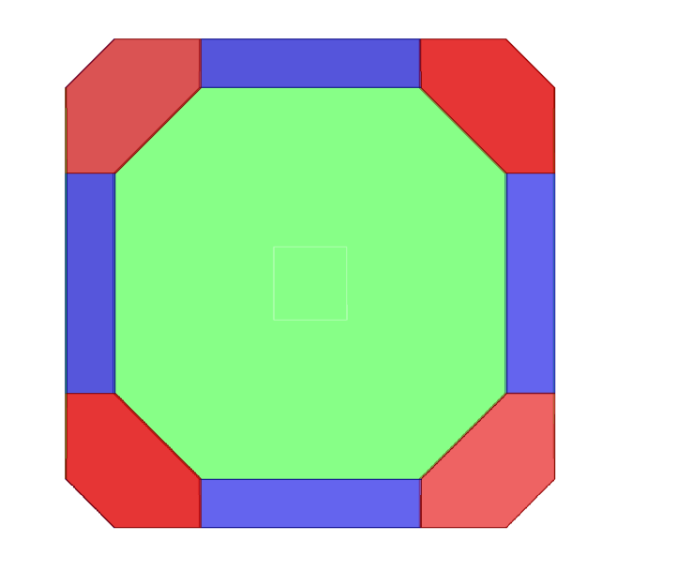
Truncated by different planes
Idea cube

Slide 5
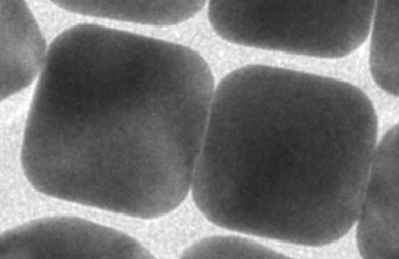
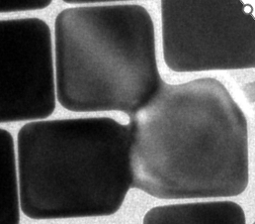
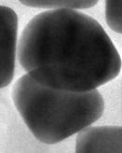
Contact without fuse
Model
Example TEM image
Segmentation strategy
Line at interface
Edge to edge
straightford
Contact with fuse
Fused at edge
Based on contrast
Fused at corner
stack
Based on edge extended to another features

